Slide 1
Lab 8 - Locking in XV6

Slide 2

New added files
ptable → for printing the processes table
setPriority → takes the Process PID and the target priority, then it returns the old priority.
pros → a program to test scheduling

Slide 3
System calls added
int setPriority(int pid, int pr) - Jacqueline
Creates a new variable called oldPrioirty
Acquires a lock on process table
Loops over all process in teh process table to look for pid match (p->pid = pid)
Once it finds the match it stores the current priority of this process in the variable called oldPriority
then sets the priority of the process to the new priority passed as parameter.
It breaks the for loop and releases the lock acquired
It then returns the variable oldPrioirty.
Void procTable(int pid) - Mira
Acquires a lock on process table
Loops over all process in the process table and prints their name
Then does if statements to check their states and prints their corresponding states
Then it prints the process id and its priority
It then releases the lock on ptable

Slide 4
Scheduling Algorithms (Jacqueline and Mira)
scheduler(void)
for(;;)
acquire lock(process table)
loop over the process table:
if(p->state != RUNNABLE) //trying to find a runnable process:
continue
maxProc = p;
// searching for the max pri
loop over the process table:
if(q->state != RUNNABLE)
continue
if(q->priority > maxProc->priority)
maxProc = q

Slide 5
cpu->proc = maxProc //switch the current process running on the CPU to this runnable process
switchuvm(maxProc)//this switches to the process page table:
//Page tables determine what memory addresses mean, and what parts of //physical memory can be accessed.
maxProc->state = RUNNING //change its state to running
swtch(&(cpu->scheduler), maxProc->context);
//maxProc->priority *= 0.95; “priority decay”
switchkvm() //switches back to the kernal page table
release lock

Slide 6
Test Program to create multiple processes (Mira)
print Parent ID = getpid()
for i = 0 to nProc:
id = fork()
if (id == 0){ //child process
setPriority(getpid(), 100-i); //decrementing the priority of the new process
sumT(i) //sum to a large number
i = nProc //terminating the child
else
for i = 0 to 100 //busy wait - to not make the parent process sleeping
k = k + 1;
ptable() //printing after the end of each process and the parent
while (wait() != -1):// status is not needed
continue
exit()

Slide 7
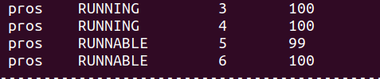
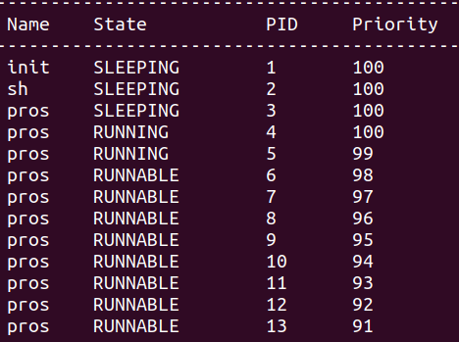
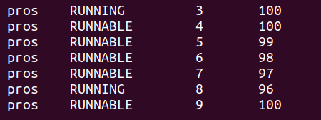
Starvation of processes - without priority decay (Mira)
Happens when the newer processes are assigned lower priority. Here process of ID = 4 runs for a long time while there is other processes which are 5 and 6 are waiting for a long time until the execution of 4 finishes to be able to start running.

Slide 8
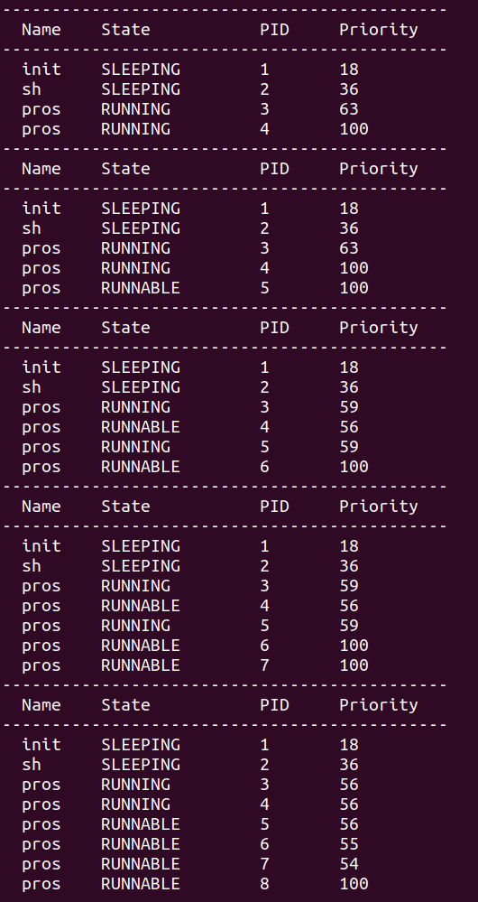
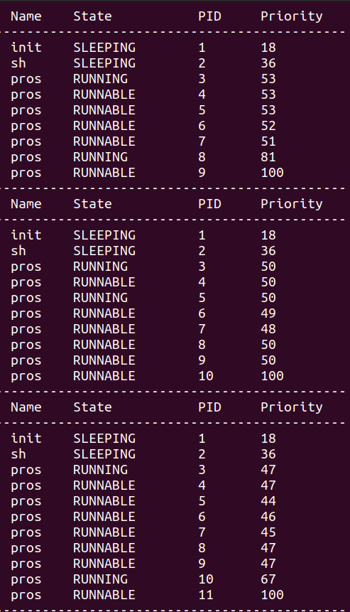
Solving Starvation by the decay

Slide 9
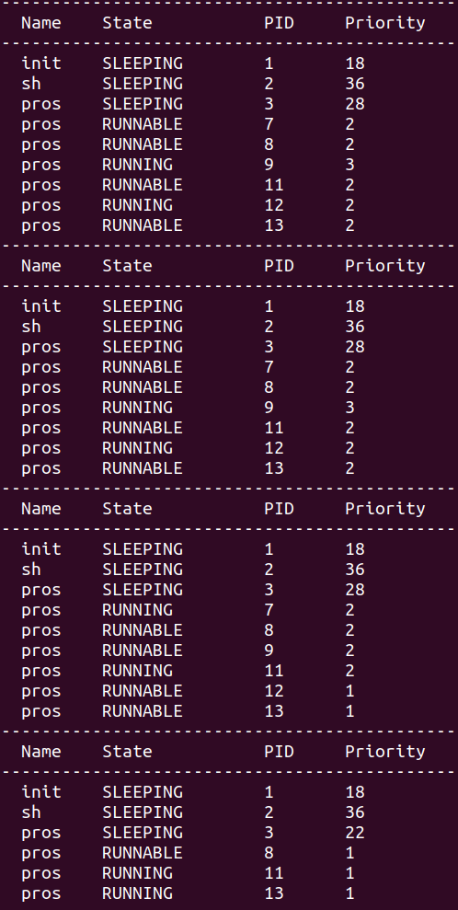
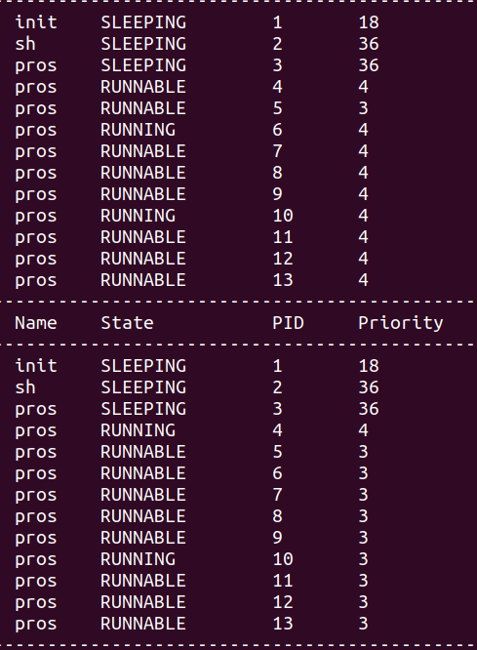
Solving Starvation by the decay

Slide 10
Xv6 Files Modified (Jacqueline and Mira)
Add #define <newsyscall> <syscall#> in file “syscall.h”
In file “defs.h” we add the new system call functions declarations under proc.c section
In file “user.h” we add system call function declarations under the system call functions
In file “sysproc.c” we define the system call functions
In file “usys.U” we add SYSCALL(<syscall_function_name>)
In file “syscall.c” we add extern int sys_<NAME> (void) and [SYS_<NAME>] sys_<NAME>,
In file “proc.c” we include the actual definition of the system call and its functionality
We then created a user program (main program) for each system call function to test it
We modified the makefile in the same way previous labs so that the new system calls are displayed as part of XV6

